Slide 1
Practical RDF Chapter 10. Querying RDF: RDF as Data
Shelley Powers, O’Reilly
SNU IDB Lab.
Hyewon Lim

Slide 2
Outline
RDF and the Relational Data Model
The RDF Query Language Issue
Roots: rdfDB QL
Inkling and SquishQL
RDQL
Jena’s RDQL
Sesame

Slide 3
RDF and the Relational Data Model
Storing RDF in a relational DB
Need to persistently store and manipulate (large amounts of) RDF data
To use the relational database technology
Basically store the model as triples
A table for storing statements
Secondary tables storing literals, resources, and namespaces
Options
Multiple models support
Use of a hash to generate the identifiers for the resources

Slide 4
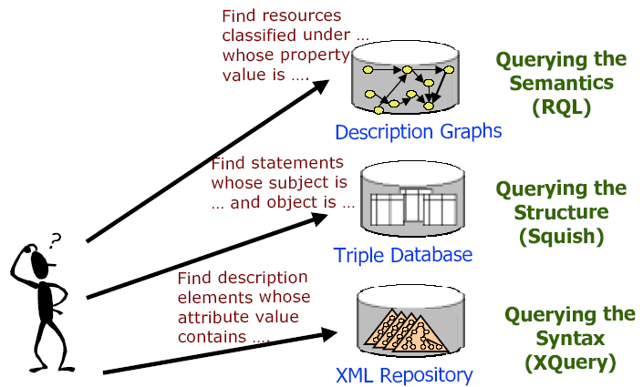
The RDF Query Language Issue

Slide 5
Roots: rdfDB QL
R. V. Guha’s rdfDB
One of the earliest persistent data stores for RDF
Written in C, primarily tested within a Linux environment
Uses a specialized language derived form SQL
RDF triple in the format of arc-source-target, not source-arc-target
Query example
Insertion
insert into test1 (type DanB Person), (name DanB 'Dan Brickley') </>
Selection
select ?x from test1 where (worksFor ?x W3C) (name ?x ?y) </>
Result
?x = DanC ?y = 'Dan Connolly'
?x = DanB ?y = 'Dan Brickley'

Slide 6
Inkling and SquishQL (1/3)
Inkling DB
Written in Java, originally on Linux and Solaris
most recently hosted and tested on Mac OS X, using Java JDBC classes
PostgreSQL required to use this DB for persistent storage
Data structure loaded into the PostgreSQL
One table containing pointers(hashed value) to the actual values in a second table
SquishQL
Supported in Inkling
Has strong ties to SQL

Slide 7
Inkling and SquishQL (2/3)
SquishQL
Basic structure
SELECT variables
FROM source
WHERE (triple clause)
USING namespace mapping
Query example
SELECT ?subject
FROM http://burningbird.net/articles/monsters1.rdf
WHERE (dc::subject ?x ?subject)
USING dc FOR http://purl.org/dc/elements/1.1/
Predicate – subject – object

Slide 8
Inkling and SquishQL (3/3)
SquishQL
query constraints
less than(<), greater than(>), equality(=), string equality(~)
Query example
Find movement resource where movement occurred on a specific date
SELECT ?resource
FROM http://burningbird.net/articles/monsters1.rdf
WHERE (rdf::type ?resource http://burningburd.net/postcon/elements/1.0/Movement)
(dc::date ?resource ?date)
AND ?date ~ “1999-10-31:T00:00:00-05:00”
USING pstcn FOR http://burningbird.net/postcon/elements/1.0/
rdf FOR http://www.w3.org/1999/02/22-rdf-syntax-ns#
dc FOR http://purl.org/dc/elements/1.1/

Slide 9
RDQL
Based on the earlier work of Guha’s RDFDB QL and SquishQL
with some relatively minor differences
Variables: ?<identifier>
Commas are required in the select clause
From, source, clause can be omitted depending on the implementation
more comparison semantics are supported
OR operator(|||), bitwise operators(& and |), negation(!)
Implementations
Jena (java)
Sesame (java)
PHP RDF/XML classes (PHP)
RDFStore (Perl)

Slide 10
RDQL Jena’s RDQL and the Query-O-Matic (1/2)
Specialized classes for use with RDQL
Query
Build or parse the query
QueryEngine
Query engine interface
QueryExecution
The actual execution of the query
QueryResults
The iterator that manages the results
ResultBinding
Mapping from variables to values

Slide 11
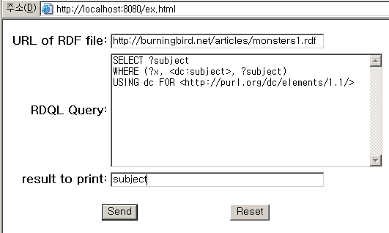
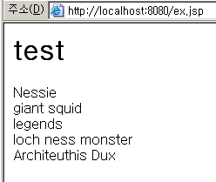
RDQL Jena’s RDQL and the Query-O-Matic (2/2)
The Query-O-Matic (created by Shelley Powers, the author of Practical RDF)
a two-page application
First HTML page containing a form
Second JSP page processing the form contents

Slide 12
Sesame
“An Open Source RDF Schema-Based Repository and Querying Facility.”
Can be used on PostgreSQL, MySQL and Oracle 9i.
RDQL, RQL, SeRQL support

Slide 13
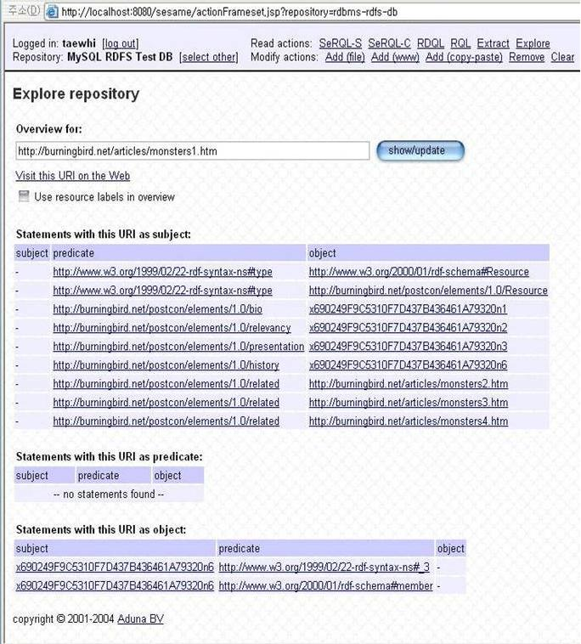
Sesame Sesame’s RDQL (1/2)
RDF/XML test document, explored in Sesame

Slide 14
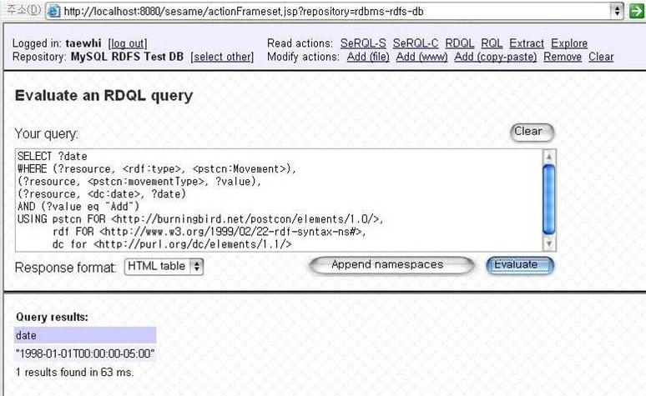
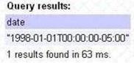
Sesame Sesame’s RDQL (2/2)
Running RDQL query and viewing the result
SELECT ?date
WHERE (?resource, <rdf.type>, <pstcn:Movement>),
(?resource, <pstcn:movementType>, ?value),
(?resource, <dc:date>, ?date)
AND (?value eq “Add”)
USING pstcn FOR <http://burningbird.net/postcon/elements/1.0>,
rdf FOR <http://www.w3.org/1999/02/22-rdf.syntax-ns#>,
dc FOR <http://purl.org/dc/elements/1.1/>

Slide 15
Sesame RQL
RQL
Querying at the semantic level
Adopts the syntax of OQL
A functional language
Queries
Access to the RDF Schema specific contents of an RDF triple store
The structure of the subclass hierarchy
Match patterns along entire paths in RDF/RDF Schema graphs
select Y
from FamousWriter{X}.hasWritten{Y}

Slide 16
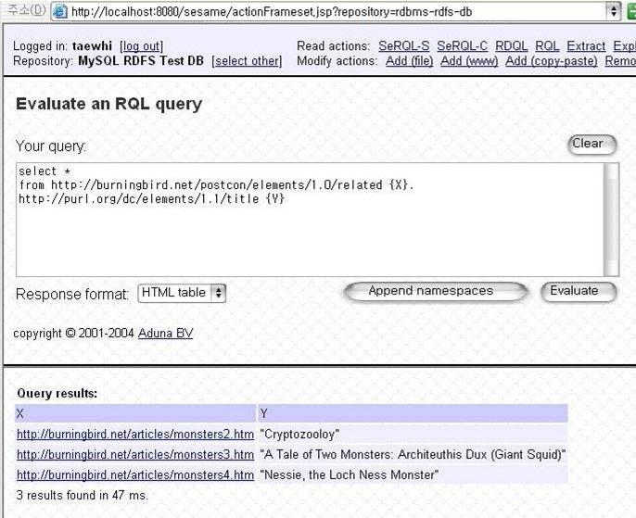
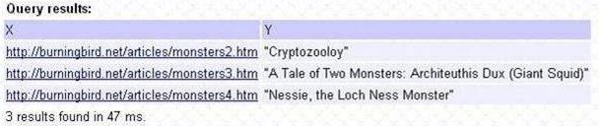
Sesame Sesame’s RQL
Running RQL query and viewing the result
SELECT *
FROM http://burningbird.net/postcon/elements/1.0/related {X} .
http://purl.org/dc/elements/1.1/title {Y}

Slide 17
Sesame SeRQL (1/4)
SeRQL
“Sesame RDF Query Language”
combines the best features of other (query) languages (RQL, RDQL, N-Triples, N3) and adds some of its own
most important features:
Graph transformation
Schema awareness – RDF Schema support
Datatyping – XML Schema data type support
Optional path matching
Expressive path expression syntax
SeRQL-S, SeRQL-C

Slide 18
Sesame SeRQL (2/4)
SeRQL-S
Select queries
SELECT O, S
FROM {S} <rdfs:label> {O}
SeRQL-C
Construct queries
CONSTRUCT
{Artist} <rdf:type> {<art:Painter>};
<art:hasPainted> {Painting}
FROM
{Artist} <rdfs:type> {<art:Artist>};
<art:hasCreated> {Painting} <rdf:type> {<art:Painting>}

Slide 19
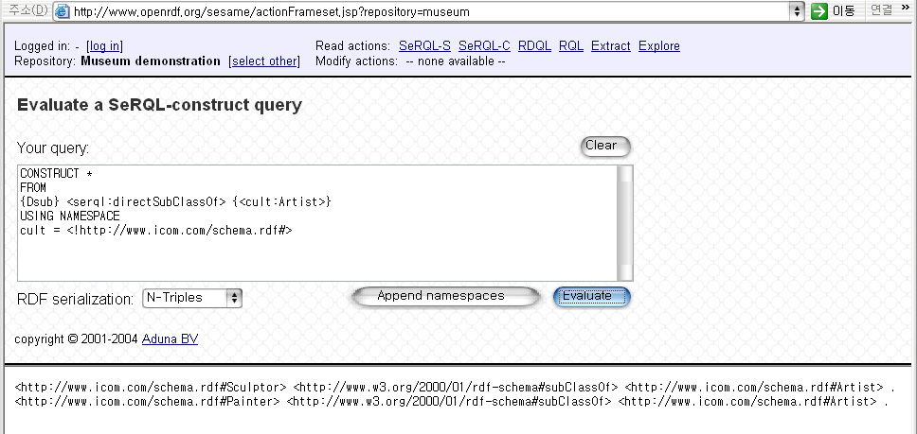
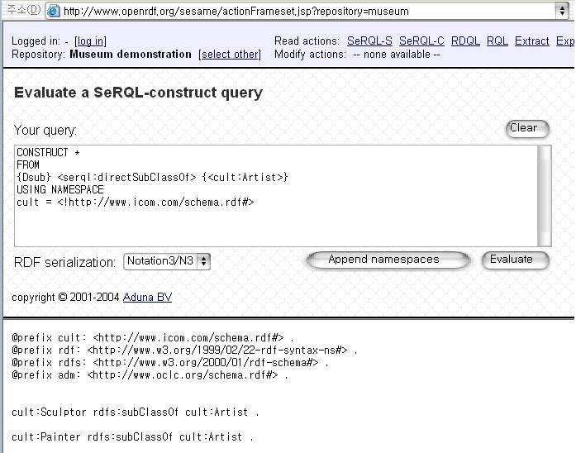
Sesame SeRQL (3/4)
result
Notes:
같은 쿼리를 날려도 표현방법에 따라 결과가 다르게 보여짐.

Slide 20
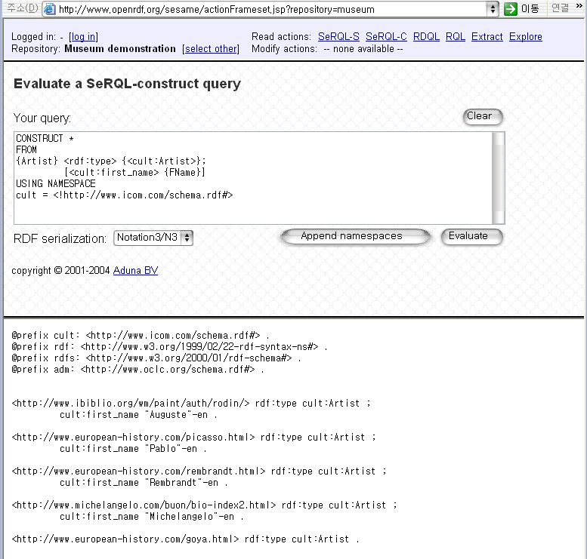
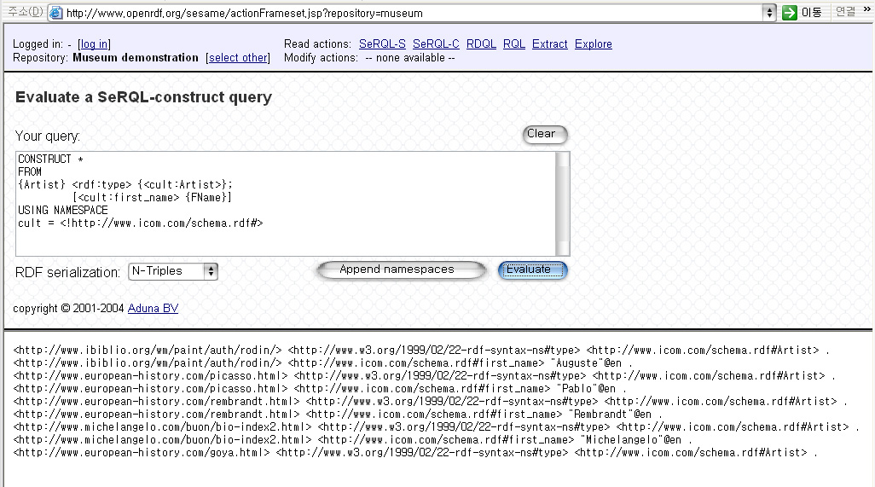
Sesame SeRQL (4/4)
result
Notes:
얘도 앞과 같이, 같은 쿼리를 날려도 표현방법에 따라 결과가 다르게 보여짐.

